Slide 1

NANDHA ENGINEERING COLLEGE
(AUTONOMOUS)
ERODE – 638 052, TAMIL NADU, INDIA.
DEPARTMENT OF ARTIFICIAL INTELLIGENCE AND DATA SCIENCE
22AIC15 – FULL STACK DEVELOPMENT - PBL - REVIEW 0
YEAR / SEMESTER : III / VI
PROJECT TITLE : REAL TIME P2P CAMPUS SERVICE HUB
Project Details | Reg No. of Candidates | Name of the Candidate | Name of the Supervisor
Batch No:19 | 23AI027 | KAVITHA K | Dr.S.D.VIJAYAKUMAR
SDG: 4,9 | 23AI040 | MONIKA B R | Designation
 |  |  | Professor

Slide 2
PROBLEM STATEMENT
Students possess valuable technical skills, project knowledge, coding experience, research insights, and competitive exam preparation strategies, but there is no structured platform inside campus to share this knowledge effectively
Knowledge transfer currently depends on informal networks, leading to loss of technical expertise, duplication of effort, and underutilization of student talent
Lack of recognition and incentive systems discourages students from actively contributing their skills and resources
The absence of a centralized digital infrastructure limits collaborative innovation and peer-driven learning within the institution
This gap directly impacts SDG 4 (Quality Education) by reducing knowledge accessibility and SDG 9 (Industry, Innovation & Infrastructure) by lacking a digital knowledge ecosystem

Slide 3
ABSTRACT
The Real-Time P2P Campus Service Hub is a MERN-based platform designed to enable structured sharing of academic, technical, and skill-based knowledge
The system allows students to post questions, share coding solutions, upload technical resources, and exchange project-related insights
A reward-driven contribution model encourages active participation and continuous knowledge exchange
The platform functions as a campus-level digital knowledge infrastructure
It creates a collaborative and innovation-focused learning ecosystem aligned with SDG goals

Slide 4
SCOPE OF THE PROJECT
Implementation at campus level covering academic, technical, and skill-based knowledge domains
Modules include Q&A system, resource sharing, points & rewards engine, and leaderboard
Categorization by domain such as programming, projects, research, placements, and competitive exams
Secure authentication and role-based access control
Administrative dashboard for content moderation and performance monitoring

Slide 5
EXISTING METHODOLOGY
Students use WhatsApp/Telegram groups for doubt solving and resource sharing
Shared content gets lost under unrelated messages
No searchable archive for questions and solutions
Files are shared via unorganized links with no categorization
No reward, quality check, or contribution measurement exists
Technical resources and coding solutions are shared without structured storage or long-term access

Slide 6
PROPOSED METHODOLOGY
Development of a centralized MERN-based digital knowledge exchange platform
Structured categorization of academic, technical, and skill-based content
Gamified reward mechanism to incentivize knowledge contribution
Real-time updates and interactive engagement features
Creation of a sustainable campus knowledge economy powered by student participation

Slide 7
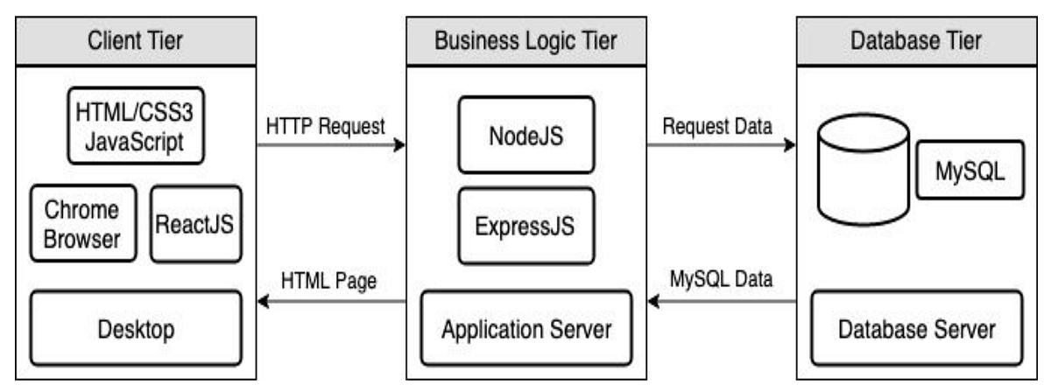
ARCHITECTURE
React.js frontend manages user interface and interactive experience
Node.js and Express.js handle backend logic, API routing, and business rules
MongoDB stores structured data including users, resources, questions, and rewards
Data flow follows: User → Frontend → Backend API → Database → Response

Slide 8
CONCLUSION
Establishes a structured digital knowledge-sharing infrastructure inside campus
Encourages innovation, collaboration, and peer-driven learning
Builds a measurable and reward-based contribution ecosystem
Preserves institutional intellectual capital
Supports SDG 4 and SDG 9 by strengthening educational access and digital infrastructure

Slide 9
FUTURE WORK
Development of a mobile application version to improve accessibility and real-time engagement
Multi-campus expansion to connect students from different institutions into a shared knowledge network
Integration with college ERP or LMS systems for structured academic collaboration
Conversion of reward points into digital certificates, campus credits, or participation recognition

Slide 10




